Slide 1



Slide 2

Our Today’s Topics
Problem & Solution
Application Workflow
The Need & The Fix
1
2
How It Works
Development Workflow
User Interface Design
3
4
Development Process
User Interface (UI)
Backend Implementation
Q & A
5
Any Questions?
6
Backend Overview

Slide 3
1. Problem & Solution
Problem
Solution
Benefits
Managing student results manually is slow, prone to errors, and inefficient. Students have delayed access to their results, and managing large datasets is cumbersome for admins.
A PHP-based Student Result Management System that automates the entire process. Admins can easily manage student details, and students can access their results online instantly.
Faster, error-free result management.
Easy access for students to view and print results.
Organized and efficient handling of student data.

Slide 4
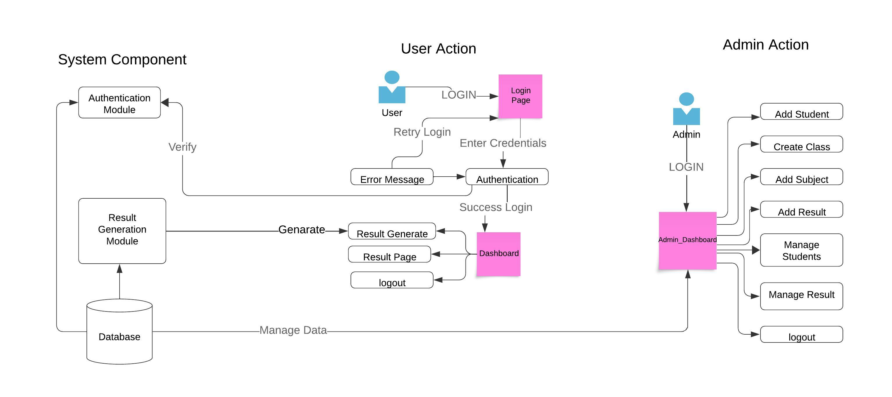
2.Application Workflow

Slide 5






3.Development Workflow
Overview of the Development Process for the SRMS Application
Requirement Gathering
Identify needs and expectations for the SRMS.
01
Design Phase
Created prototypes for user interfaces.
02
Development
Implemented the system using PHP and MySQL.
03
04
Testing
Conducted user acceptance testing and debugging.
Deployment
Launched the application for end-users.
05
06
Feedback and Iteration
Collected feedback for continuous improvement.

Slide 6
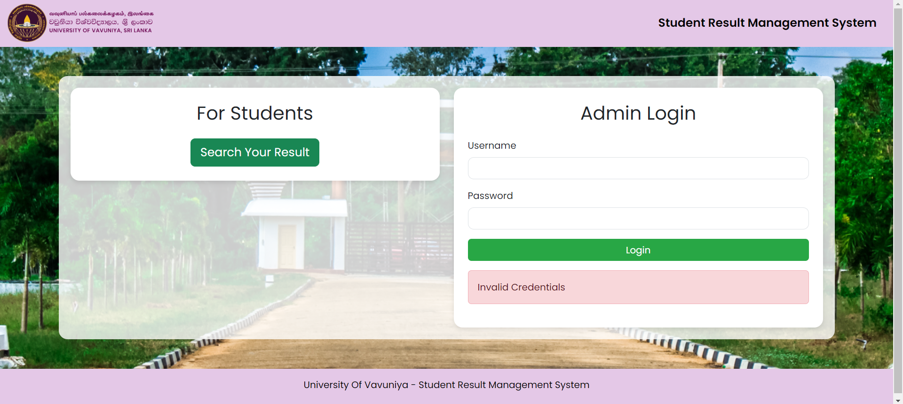
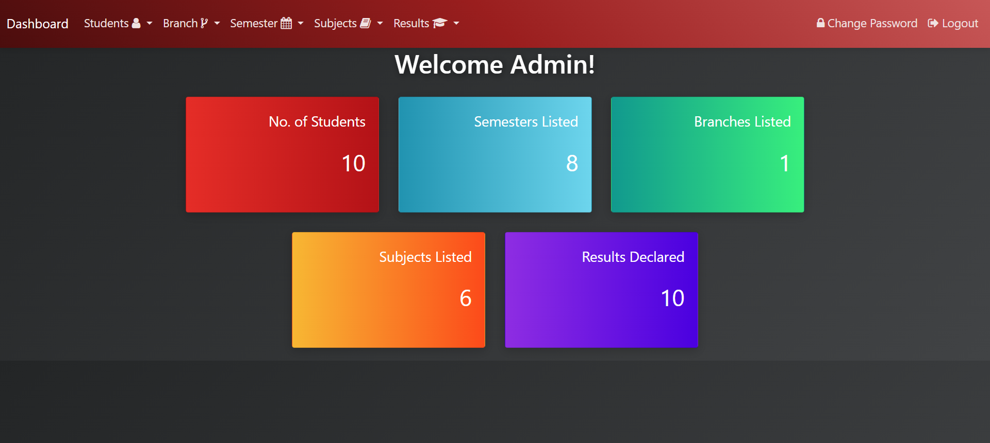
4.User Interfaces

Slide 7
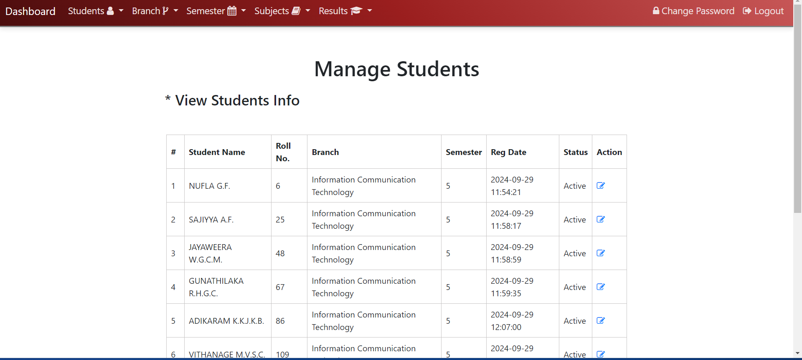
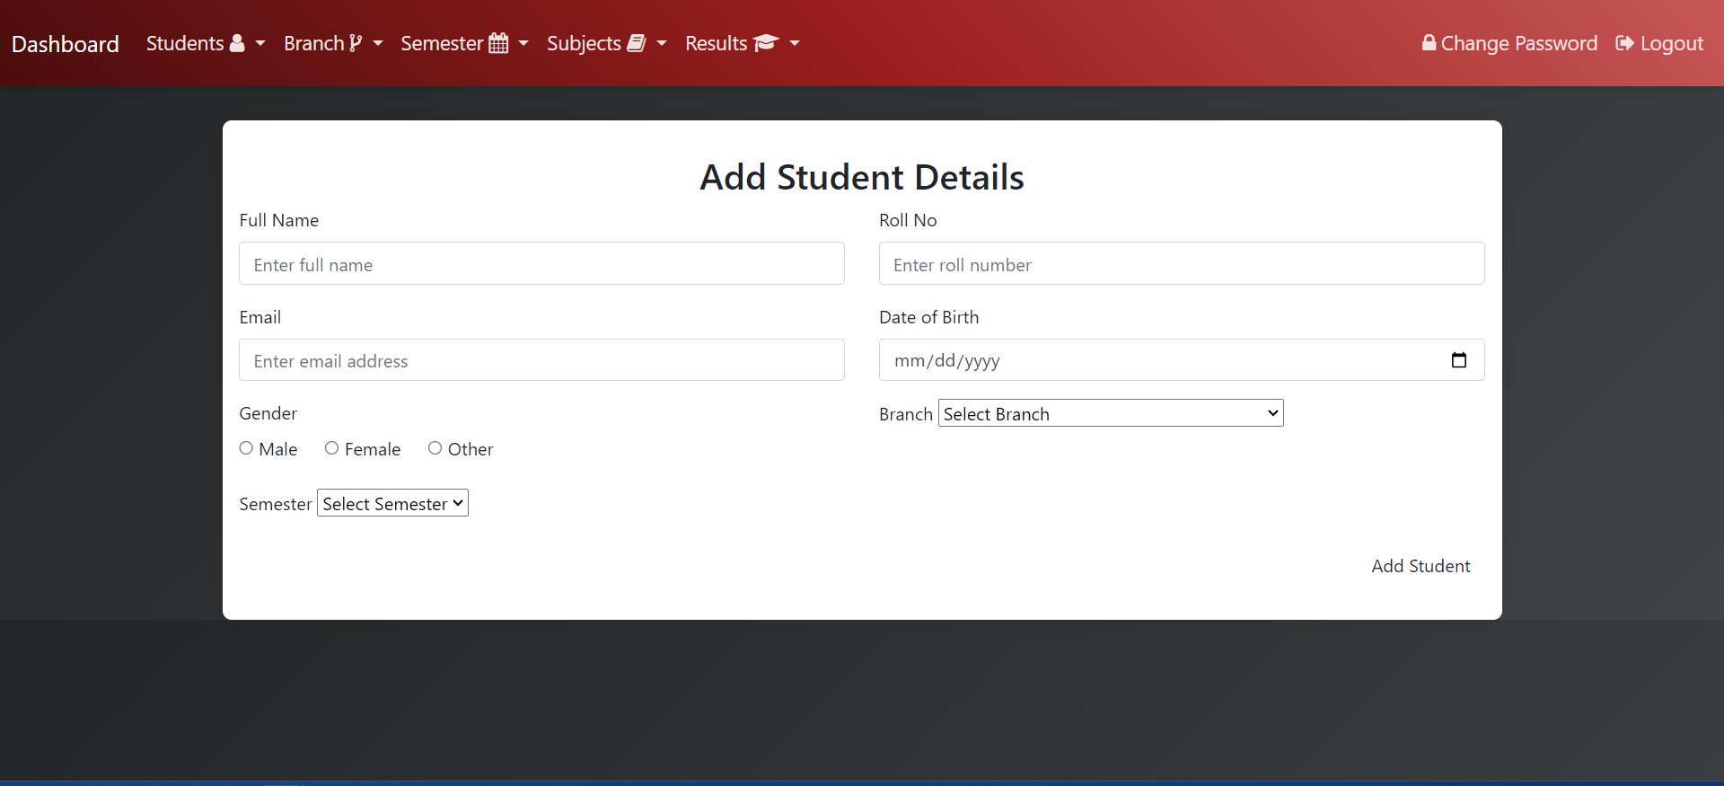
4.User Interfaces

Slide 8
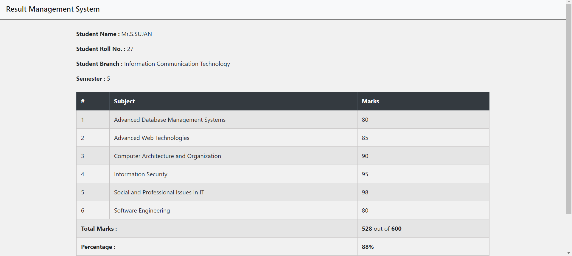
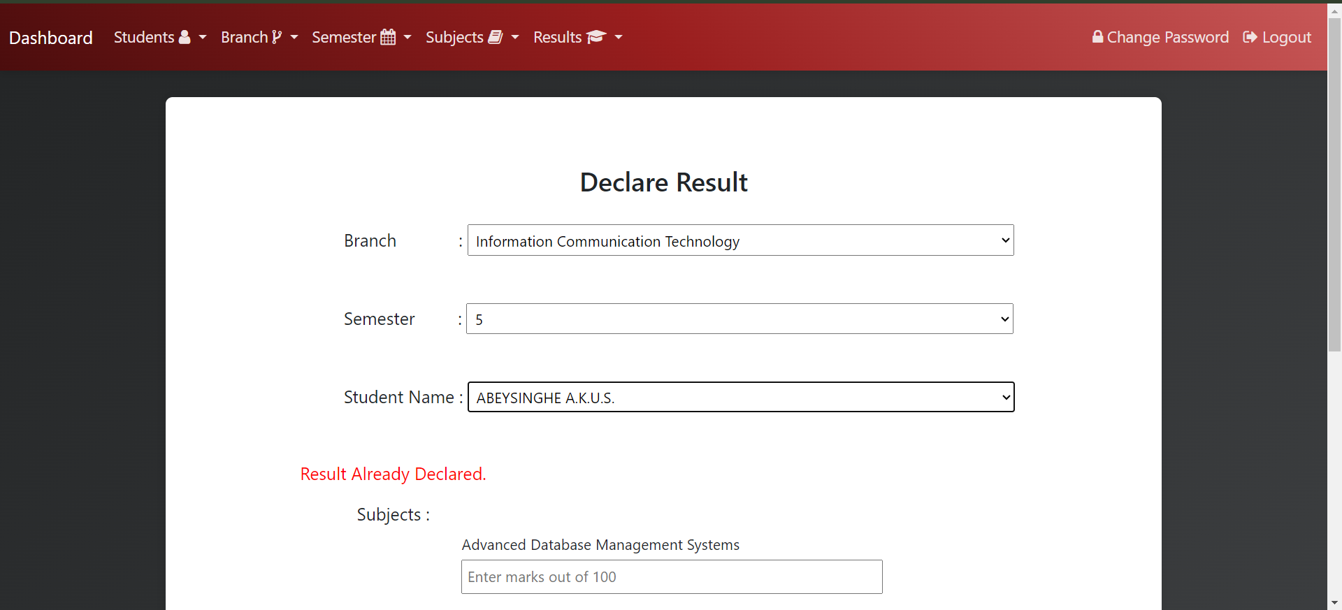
4.User Interfaces

Slide 9





4.User Interface Design Tools
and techniques
HTML
CSS
JS
Bootstrap
JQuery
Ensures a responsive design
provide smooth dynamic updates
creating the structure
styling the
interface
Enhance user interactivity

Slide 10



5. Backend Implementation Tools
and techniques
PHP
MYSQL
XAMPP
Manages server-side logic for CRUD
Manages data storage for student records.
Used as a local development environment.

Slide 11



5.Backend Overview
Admin Role
Student Role
Special Feature
Admins have full control over the data, with the ability to add, update, delete, and view student information and subjects
Students can view results securely using their unique student number and print them in a structured format.
The system provides real-time updates, ensuring students can access accurate results online anytime and easily print them in a proper format.

Slide 12


Our Team
A
A
A
A
A
NUFLA
SAJIYYA
CHARITHA
CHATHURANGA
JITHMI
2019/ICTS/06
2019/ICTS/25
2019/ICTS/48
2019/ICTS/67
2019/ICTS/86
A
A
A
A
A
CHAMUDI
NASHAN
UMESHA
SITHUM
SUJAN
2019/ICTS/109
2019/ICTS/126
2019/ICTS/145
2019/ICTS/166
2018/ICTS/27

Slide 13


Q & A
Got Questions? Let's Explore the Answers Together in Our Interactive Q&A Session!

Slide 14

Thank You!
Thank You for Your Time! Let’s Stay Connected and Continue the Journey Together!

